Slide 1
ONLINE VOTING SYSTEM
GROUP NUMBER:4
MODULE: DATABASE PROGRAMMING AND ADMINISTRATION (COU 07502)
DATE: 3/3/2026

Slide 2
MEMBERS
EWARD EDWARD LUTEMA -230242454635
EUNICE MONICA KAHELO -230242417582
GERMANUS YENS NDUNGURU -230242427755
EDDY VICTOR MWAKALINGA -230242437523
NELSON FELICHISM SHAYO -230242467611

Slide 3
INTRODUCTION
Background study
What is the Online Voting System?
Voting is a fundamental democratic process for collective decision-making
Traditional paper-based voting has been widely used but presents limitations
Advancement in IT has enabled transition to automated digital systems
Online voting systems improve efficiency, accuracy, and accessibility
A secure web-based platform for conducting electronic elections
Allows users to register, authenticate, and cast votes remotely
Incorporates role-based access control (Administrators vs. Voters)
Built with PHP (backend) and Oracle Database (data management)

Slide 4
Challenges with Traditional Voting Systems
Challenges with Traditional Voting Systems
Problem | Impact
Manual vote counting | Time-consuming, prone to human error, delays in results
Physical presence required | Limits voter participation
Printing ballot papers | High operational costs
Ballot tampering/misplacement | Security risks
Duplicate voting | Compromises election fairness

Slide 5
IMPORTANCE OF THE PROJECT
Practical application of database management systems and web technologies
Real-world solution for institutions to modernize election processes
Educational tool for understanding:
  System design
  Secure authentication
  Database implementation
Cost-effective alternative to commercial platforms like SimplyVoting/ElectionBuddy
Customizable for institutional needs
Locally hosted - better data privacy and control

Slide 6
General Objective
To develop a secure and efficient Online Voting System that facilitates electronic elections.
Secure user registration and login
Create secure sessions for authenticated users
Provide administrator with centralized management interface
Prevent duplicate voting for the same position
Display real-time vote counts for all candidates and positions
Specific Objectives

Slide 7
METHODOLOGY - WATERFALL MODEL
Phase 1: Requirement Analysis
Studied existing manual voting system at DIT
Interviewed students and lecturers
Identified requirements:
  User: Simple registration, easy login, clear voting interface
  Admin: Manage candidates, monitor voting, view results
  Security: Prevent duplicate voting, secure passwords, role-based access
  Technical: Web-based, Oracle database, real-time results

Slide 8
METHODOLOGY (Continued)
Phase 2: System Design
Database Design: Users, Candidates, Votes tables
Key Decisions: Primary keys, foreign keys, unique constraints, sequences, triggers
UI Design: Wireframes for registration, login, dashboards, results
Phase 3: Implementation
Backend: PHP scripts for registration, login, voting, results
Frontend: HTML, CSS, JavaScript
Phase 4: Testing
Unit testing, integration testing, security testing, UAT

Slide 9
SYSTEM DESIGN - DATABASE STRUCTURE
Three-Tier Architecture
Presentation Layer - User interface (web pages)
Application Layer - Business logic (PHP)
Database Layer - Data storage (Oracle Database)
Table | Purpose
USERS | Stores voter and admin information
CANDIDATES | Stores candidate details
VOTES | Records all votes cast

Slide 10
DATABASE DESIGN - USERS TABLE
Column | Data Type | Constraint | Description
id | NUMBER | PRIMARY KEY | Unique identifier
full_name | VARCHAR2(100) | - | User's full name
username | VARCHAR2(100) | UNIQUE | Login username
password | VARCHAR2(255) | - | Encrypted password
role | VARCHAR2(20) | - | Admin or Voter
created_at | DATE | DEFAULT SYSDATE | Registration timestamp

Slide 11
DATABASE DESIGN - CANDIDATES TABLE
Column | Data Type | Constraint | Description
id | NUMBER | PRIMARY KEY | Unique candidate ID
name | VARCHAR2(100) | NOT NULL | Candidate name
position | VARCHAR2(50) | NOT NULL | Position contested
election_year | VARCHAR2(4) | NOT NULL | Year of election
election_date | DATE | NOT NULL | Election day
photo | VARCHAR2(255) | - | Photo path
created_at | DATE | DEFAULT SYSDATE | Record timestamp

Slide 12
DATABASE DESIGN - VOTES TABLE
Column | Data Type | Constraint | Description
id | NUMBER | PRIMARY KEY | Unique vote ID
user_id | NUMBER | FOREIGN KEY | Who voted
candidate_id | NUMBER | FOREIGN KEY | Who they voted for
position | VARCHAR2(50) | - | Position voted
vote_time | TIMESTAMP | DEFAULT | When vote happened

Slide 13
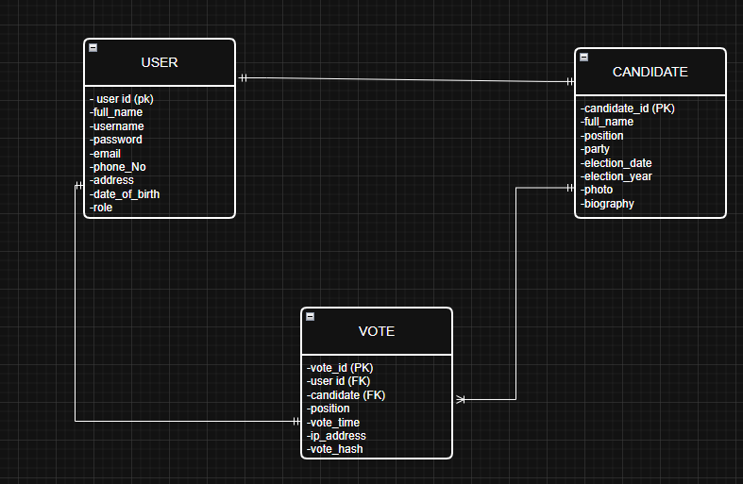
ERD DIAGRAM
USER → VOTE: One-to-Many (one user can cast many votes)
CANDIDATE → VOTE: One-to-Many (one candidate can receive many votes)

Slide 14
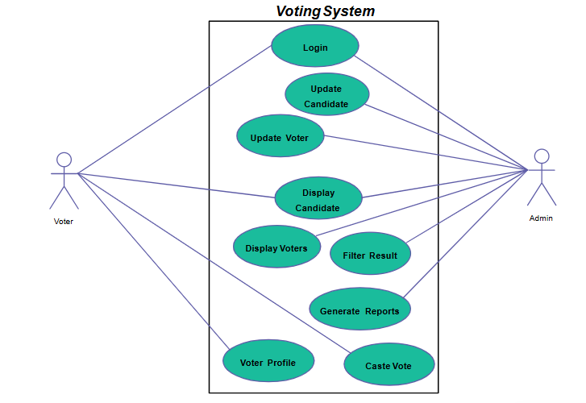
USE CASE DIAGRAM

Slide 15
USE CASE explanation
Actor | Description
Voter | Regular user who registers and casts votes
Administrator | System admin who manages the election process
Main Use Cases
Both: Login, Display Candidate, Filter Result
Voter Only: Cast Vote, Voter Profile
Admin Only: Update Candidate, Update Voter, Display Voters, Generate Reports

Slide 16
Database Design and Implementation
Implementation: Created three main tables (Users, Candidates, Votes) with appropriate data types, constraints, and relationships.
Evidence:
PRIMARY KEY constraints for unique identification
FOREIGN KEY constraints linking tables
UNIQUE constraint preventing duplicate voting

Slide 17
LEARNING OUTCOMES
( Database Design & Integrity)
Learning Outcome 1: Database Design and Implementation
Created three main tables (Users, Candidates, Votes) with appropriate data types
Established proper table relationships through primary and foreign keys
Designed to store all election data efficiently and securely
Learning Outcome 2: SQL Programming Implementation
Used INSERT statements for adding new users, candidates, and votes
Implemented SELECT queries for retrieving candidate lists and results
Applied UPDATE and DELETE for data management

Slide 18
Conti…
Learning Outcome 3: Data Integrity and Constraints
PRIMARY KEY constraints - Ensures unique record identification
FOREIGN KEY constraints - Maintains referential integrity between tables
UNIQUE constraint - Prevents duplicate usernames and duplicate voting
NOT NULL constraints - Ensures required fields have values
DEFAULT constraint - Automatically sets timestamps for records

Slide 19
Conti..
Learning Outcome 4: Database Triggers
User Trigger - Automatically assigns user ID before insert
Candidate Trigger - Automatically assigns candidate ID before insert
Votes Trigger - Automatically assigns vote ID before insert
Purpose: Ensures automatic, consistent ID generation without manual input
Learning Outcome 5: Database Sequences
Created sequences as automatic number generators for all tables
User sequence - Generates unique user IDs
Candidate sequence - Generates unique candidate IDs
Vote sequence - Generates unique vote IDs

Slide 20
Conti..
Learning Outcome 6: Security Implementation
Password hashing - Passwords encrypted before storage
Session management - Secure user sessions after login
Role-Based Access Control (RBAC) - Different privileges for admins vs voters
Prepared statements - Prevents SQL injection attacks
Authentication system - Login verification before access

Slide 21
TESTING AND RESULTS
Test Type | What We Tested | Results
Unit Testing | Individual functions (login, registration, vote casting) | All functions worked correctly
Integration Testing | How modules work together | Smooth data flow between frontend, backend, database
Security Testing | Authentication, duplicate voting | System blocked all unauthorized attempts
Duplicate Voting Test | Trying to vote twice for same position | System rejected second attempt
User Acceptance | Real users tested system | Positive feedback, easy to use

